Slide 1
„Healthy EU“ 2016-1-FI01-KA201-022772

Slide 2
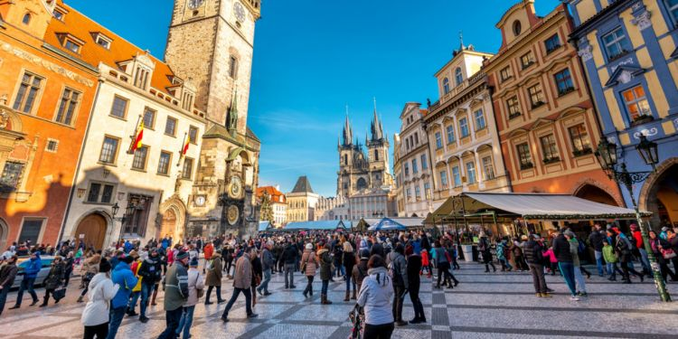
Lifestyle in the Czech republic

Slide 3
Public holidays
January 1st – establishing of the Czech Rep. (1993)
Easter Monday
May 1st – Labour Day
May 8 – 1945 Liberation Day
July 5 – St Cyril and St Method Day
July 6 – Commemoration of the death of Jan Hus (allegory of the struggle against Catholic, imperial and German oppression)
September 28 – St Wenceslas (patron of Bohemia)
October 28 – Republic Foundation Day
November 17 – Commemoration of the Velvet Revolution
December 24, 25 and 26 – Christmas

Slide 4
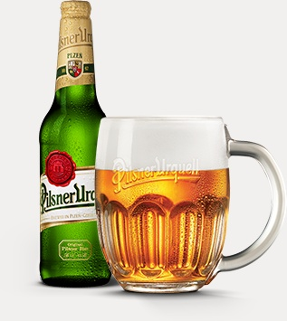
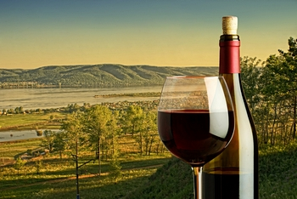
Drinks
Beer is the most popular drink in the Czech Republic. In fact, the country is often cited as the biggest beer consumer in the world.
Known as the homeland of pilsner (a type of pale lager), the country is a popular destination for beer drinkers from all over Europe.
Wine is also an essential part of the national culture, especially the Bohemian wine. South Moravia is also a region noted for its Riesling wines.

Slide 5
family
The Czech greatly value family ties. Parents, children, and grandchildren always find the time to catch up and family dinners are part of the traditional lifestyle. And, despite modernisation and considerable changes over the years, families still hold a significant importance in the life of Czechs.

Slide 6
Typical Czech family
nuclear families with 2 children, but 45% of marriges broke up in 2016
sometimes extended families with grandparents living saparetely but in the same house
very popular are pets: dogs, cats, rabbits, rats, guinea pigs and hamster, fish aquarium, turtles or parrots

Slide 7
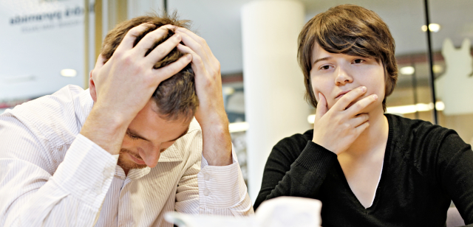
Divorce rate in the czech republic
the divorce rate is slowly decreasing in recent years
The avarage marriage lasted for 13 years
45% of marriges broke up in 2016

Slide 8
Czech Family
Czech families are usually very small, averaging one or two children per family. A married couple with a child will usually see the mother staying at home to care for the child in its very early years. The Czech government in very generous in supporting this decision, as it requires employers to pay 90% of the mother's salary while she is away for up to 6 months, and then 60% after that 6 months, but only up to when the child is 3 years old. The mother will typically return to work as soon as possible, usually once she finds a nursery or when a family member can help with the child, usually a mother-in-law.
Children are expected to be neat, orderly, and respectful and are expected to excel in school. Higher education is encouraged by Czech parents and it is very embarrassing to a Czech family when a child has to repeat a grade. Universtities are free, which makes access to education even easier for children.

Slide 9
Daily routine of Czech teenagers
6:30 – 7:00 waking up
7:00 – 8:00 getting to school
8:00 – 14:00 (15:30) studying at school, lunch
15:00 – 18:00 school clubs x free time activities
18:00 – 20:00 family time, dinner, free time
22:00 – 23:00 going to bed

Slide 10
Basic facts
17% of Czechs tries to follow the healthy lifestyle
32% smoke cigarettes
14% of abstinents, 14% hardly ever drink alcohol, 70% sometimes drink alcohol
31% do not go to gym regularly, 44% go to gym regularly
52% go to bed at nearly the same time
31% feel tired,32% have problems with their sleep,
62% are satisfied with their job
34% feel that they are endangered with burn out effect

Slide 11
LIFE style facts
Czech Republic as the sixth safest place to live on earth
Czech is the second most difficult language to learn
the highest beer consumption per capita in the world
one of the least religious populations in the world (only 19% believe in God)
Mushroom hunting is a favorite pastime of the Czech people
the lowest unemployment rate in the European Union
Popular food: roast pork with bread dumplings and stewed cabbage, potato pancakes, beef in dill sauce with dumplings, roast duck with cabbage and dumplings, goulash, etc.
the highest EU death rate from cancer
No shoes inside :D

